Slide 1
Software Development Processes
HUMAN SIDE OF TECHNOLOGY
1

Slide 2
Topics
Software Development Process Models
MSF (Microsoft Solution Framework)
System Architecture Presentation
MDE (Model Driven Engineering)

Slide 3
Software Development Process Models
Model:
Defines project activities and their sequence
Defines projects life-cycle.
Models are:
static, have clearly defined stages
Have no clearly defied stages and their boundaries.

Slide 4
Waterfall Model
Milestones as transition and acceptance points.
Transition between phases requires finishing all tasks, activities of a phase.
Requirement's change is expensive.

Slide 5
Spiral Model
Based on repeated tuning of requirements, project costs, and plans.
Works effectively on small projects.
End user is involved into the project.
No clearly defined project milestones.

Slide 6
MSF Process Model
Phase based; milestone driven iterative model.
Combines best practices of waterfall ant spiral models:
Waterfall milestones,
Spiral iterations.
Phases:
define,
plan,
develop,
stabilize,
deploy.

Slide 7
MSF Team Roles
Product manager
Program manager
Developer
Tester
Release manager
User experience

Slide 8
Risk Management Process
Risk identification
Risk analysis
Risk planning
Risk monitoring
Risk management
Lessons learned

Slide 9
Preparation for Project
Process for obtaining
knowledge,
abilities, and
skills,
for managing projects and building solutions.

Slide 10
Project Management
Perform integrated planning and changes management.
Define and manage project scope.
Define and manage project costs.
Define and manage project schedules.
Procure required resources for a project.
Manage contacts and suppliers, ensure resources delivery.
Alleviate internal-external project stakeholders communication.
Handle project risks.
Document and monitor team quality process.

Slide 11
Trade-offs Management
All projects are constrained, priority should be given to two parameters.
Helpful template:
Given fixed ____________, we choose ___________ and change ___________ if needed.

Slide 12
Project Iterations
Define release plan for multiple project versions.
Regularly provide intermediate versions.
Core product functions get priority.
High risk features are implemented first.

Slide 13
System Architecture Presentation
Use case view:
Use case diagram
Logic view:
Class diagram,
Package diagram.
Process view:
State diagram,
Sequence diagram,
Collaboration diagram.
Deployment view:
Deployment diagram.
Implementation view:
Component diagram.

Slide 14
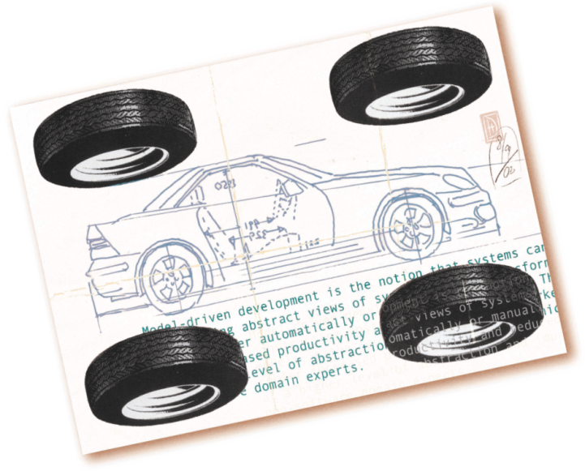
MDE / MDD / MDA
Model Driven Engineering
Model Driven Development
Model Driven Architecture

Slide 15
MDE, MDD, MDA ideas
System development ends with a model.
No coding.
Transformations build system code.
Developer
models system,
picks technologies,
selects components.
Tools that are based on selected transformations build full system implementation.

Slide 16
The change if the Abstraction Level
Systems are built in higher and higher abstractions levels.

Slide 17
CASE Failure
Not used in practice.
Causes:
Immature tools,
Code-model synchronization problems,
Insufficient model details.
Models were not used for directly building system and were considered as additional expenses.

Slide 18
Todays Problems
Platform's complexity is bigger than the abstraction level that programming languages can provide:
Quickly evolving of platforms,
Code rewrite is needed on platform change.
Plenty of effort is needed for deployment and development while building systems unsing high level languages and platforms

Slide 19
Model Driven Engineering
DSML (Domain Specific Modelling Language):
DSML type system allows to formalize system behaviour, structure and requirements in specific domain.
DSML are defined by meta-models that define relations between domain specific concepts and precisely define core semantic and constraints.
Transformations and Generators
Analyse specific aspects of models,
Afterwards generate system artefacts such as code, input data, deployment descriptors, alternative view models.

Slide 20
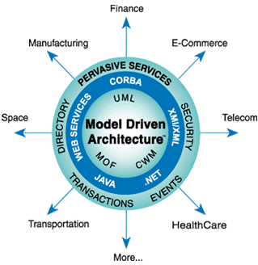
Model Driven Architecture
MDE implementation
OMG standard

Slide 21
MDA Goals
MDA is developed for:
Faster software development,
Improved software quality,
Reduce manual development,
Reduce coupling to technologies (ex.: JAVA, .NET, ASP),
Fast reaction to change requests.

Slide 22
Classic and MDA Software Development
Classic
MDA

Slide 23
Development with MDA
Only modelling.
Implementation by transformations.

Slide 24
Development with MDA (detailed)

Slide 25
MDA Models
CIM – Computation Independent Model
Defines domain and requirements.
PIM – Platform Independent Model
Defines system functions independently from platforms.
PSM – Platform Specific Model
Defines system behaviour within selected platforms.

Slide 26
PIM
Platform independent model that
Define system functions,
Define system data.

Slide 27
PSM
Platform specific model that define system functions and data that are adapted to selected platforms.
Uses platform specific features.
Matches specification model.

Slide 28
PSM (EJB, JSP)
PIM is transformed to
EJB,
JSP,
ER.
Web System Model (JSP)
Data Base Model (ER Diagram).
EJB Model

Slide 29
Transformations
Model to model conversion.
QVT standard.
Doman expert knowledge storage.

Slide 30
Transformations Roles
Transformation definition in a tool
Transformation between source and target languages

Slide 31
Transformations Features
Adaptable
Traceable
Step by step
Bi-directional

Slide 32
Transformations Language
QVT standard
Implementations by tools vendors

Slide 33
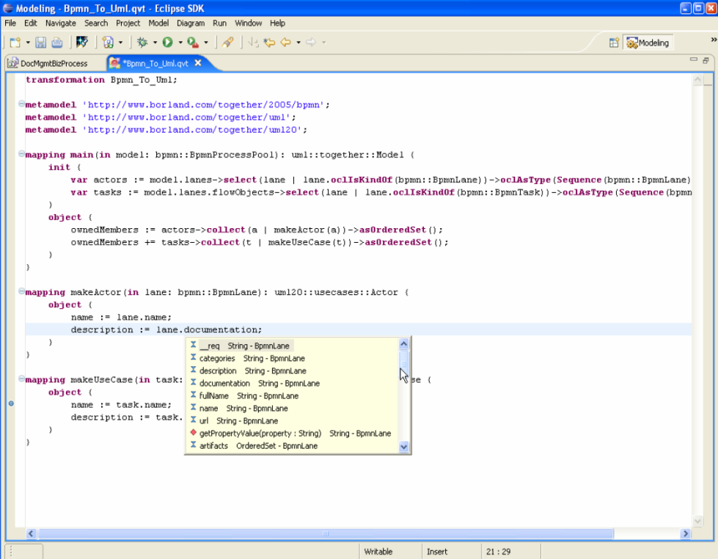
QVT
Query
View
Transform

Slide 34
Meta-Models
Model is defined by model.

Slide 35
M0-M1-M2-M3 Level Modes
M0 – what to model.
M1 – models (ex: UML).
M2 – meta-models (ex: abstract model syntax in UML)
M3 – meta-meta-model.

Slide 36
MOF
Meta Object Facility.
Self definition.
For defining M3 level.

Slide 37
Full MDA
Meta-language
Transformation's language
PIM, PSM
Transformation tools

Slide 38
Assumptions for MDE / MDA success
Existence of tools covering all processes.
Tool's ease of use.
Tool's adoptability.
Notes:
Pritaikomumas – transorfmaciju gausa

Slide 39
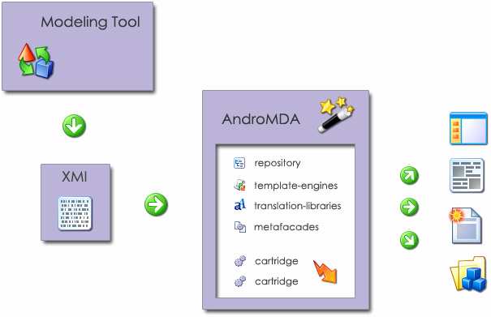

AndroMDA
http://www.andromda.org/
Open-source.
Command line.
One way transformations.

Slide 40
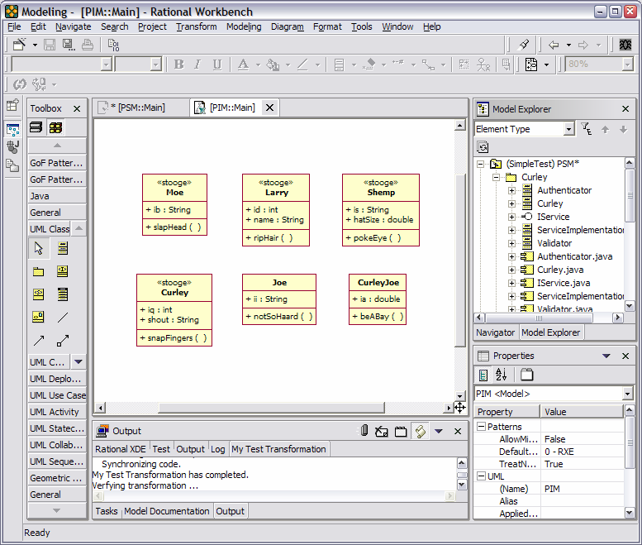
Rational XDE MDA Toolkit
Modelling and generation tool.
No transformations.

Slide 41

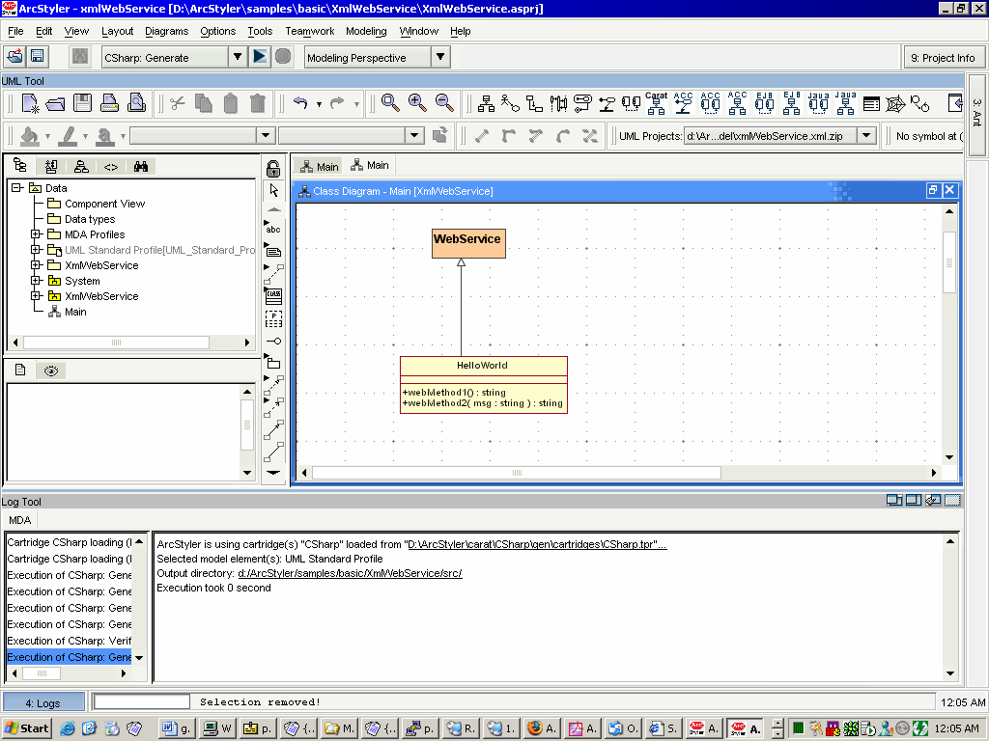
ArcStyler
http://www.arcstyler.com/
Commercial
Based on Magic Draw
Full development environment
Plenty of pre-made transformations

Slide 42

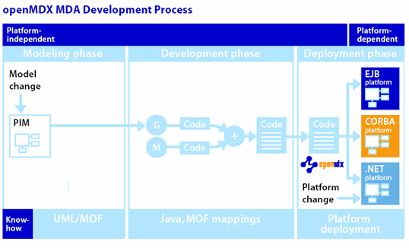
OpenMDX
http://www.openmdx.org/
Open-source
Command line
Java, .NET
One-way transformations

Slide 43

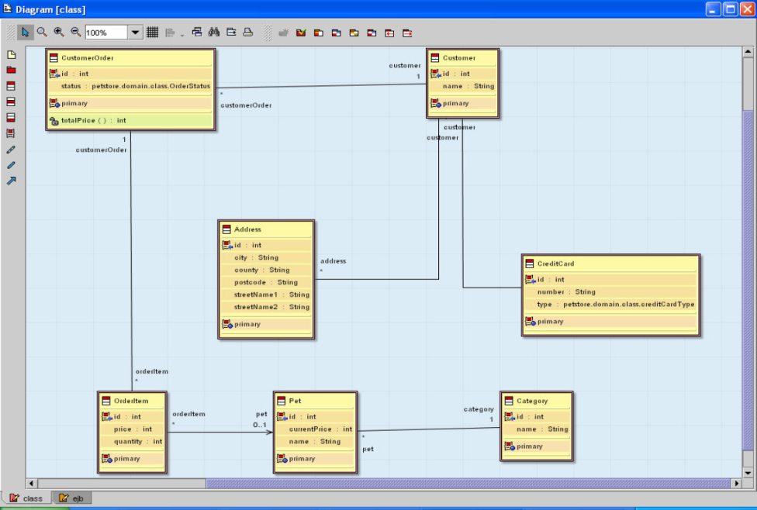
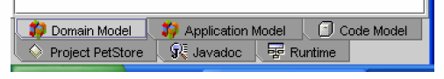
OptimalJ
Commercial
OMT notation
Integrated development environment
Bi-directional transformations
Java

Slide 44
Summary
Software is developed adhering to development processes.
MSF – iterations with milestones.
Compromise triangle can resolve project constraints.
MDE – new software development approach.
MDE – software is modelled and generated.

Slide 45
References
Turner, M.S.V., Microsoft Solutions Framework Essentials. 2009: Microsoft Press. 340.
Kruchten, P., The rational unified process : an introduction. 3rd ed. 2003, Boston: Addison-Wesley. 336.
Blanc, X., MDA en action. Ingéniere logicielle guidée par les modèles. 2005, Paris: Groupe Eyrolles. 270.

